Slide 1
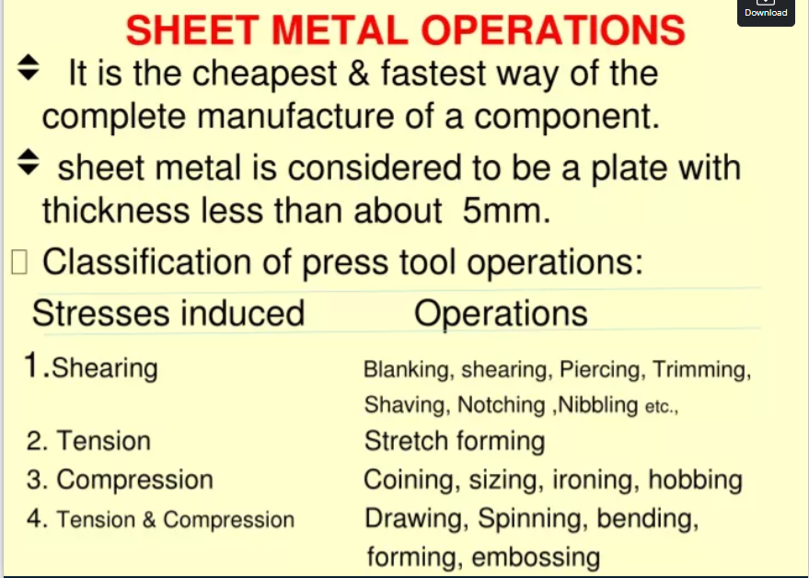

Slide 2
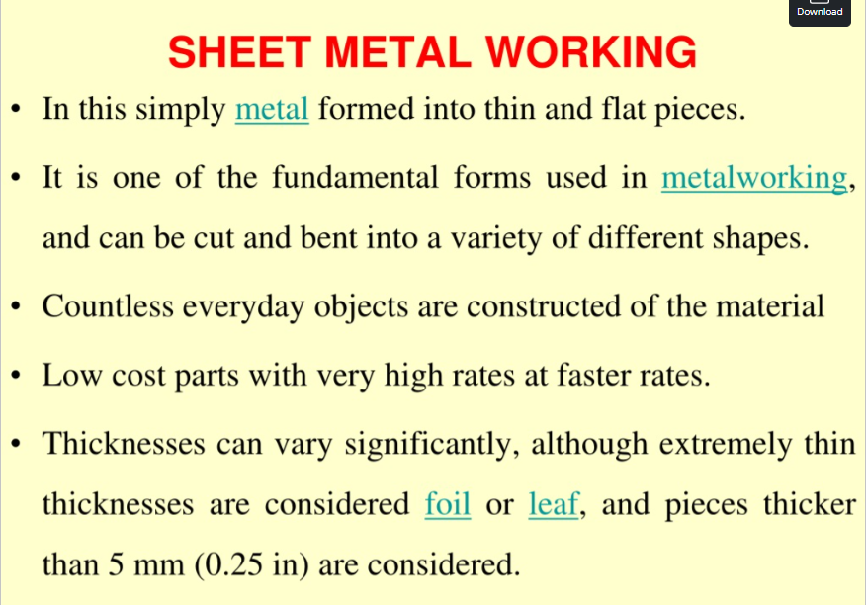

Slide 3
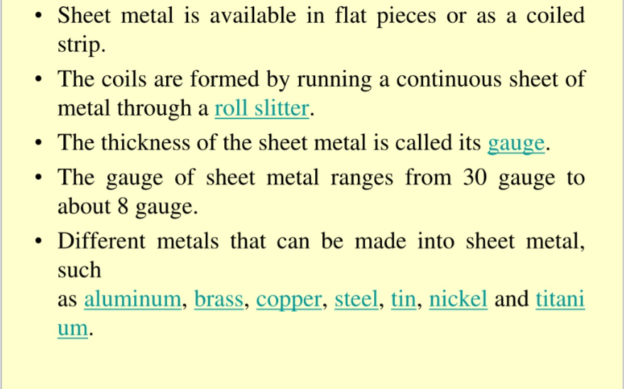

Slide 4
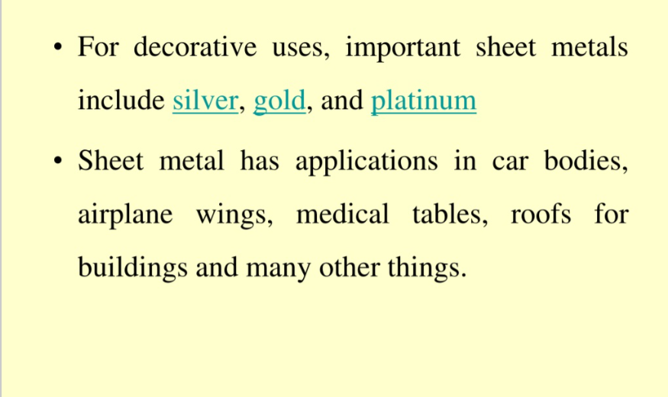

Slide 5
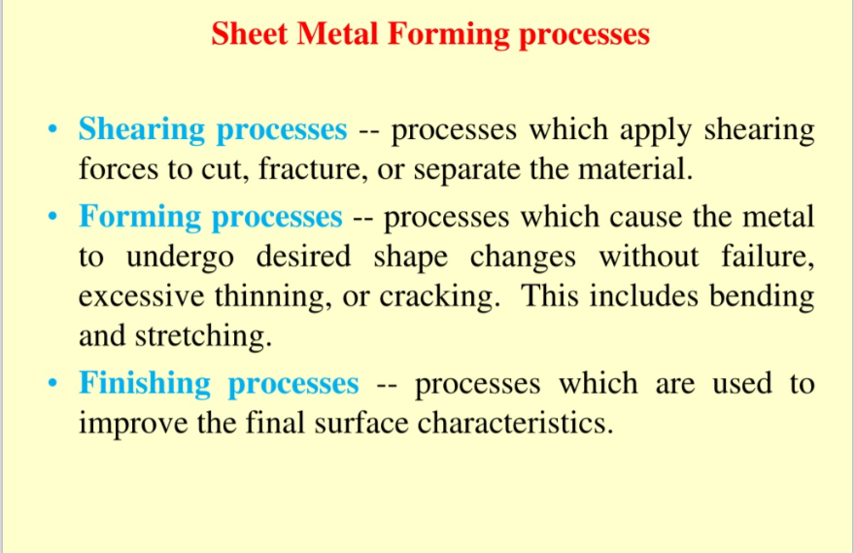

Slide 6
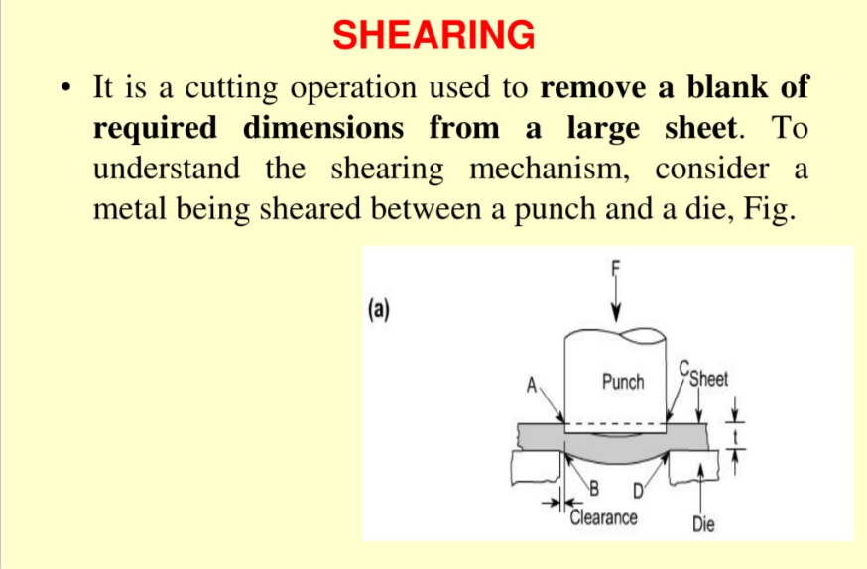

Slide 7
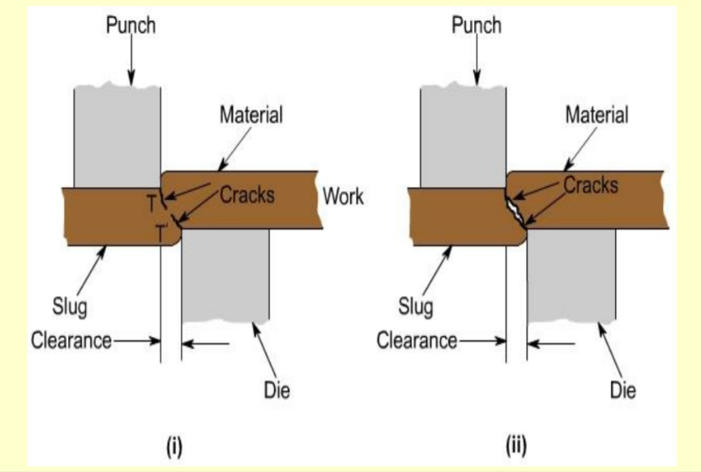

Slide 8
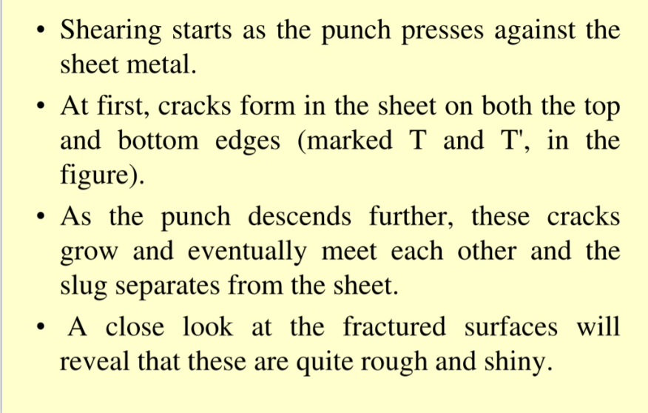

Slide 9
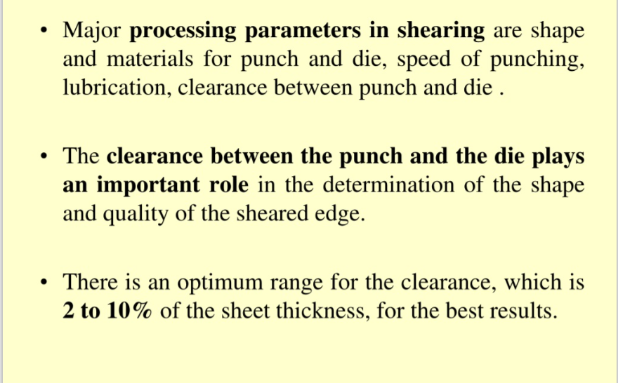

Slide 10
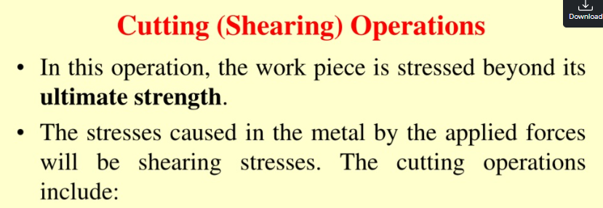
Blanking
Punching or piercing
Trimming
Shaving
Notching
Nibbling

Slide 11
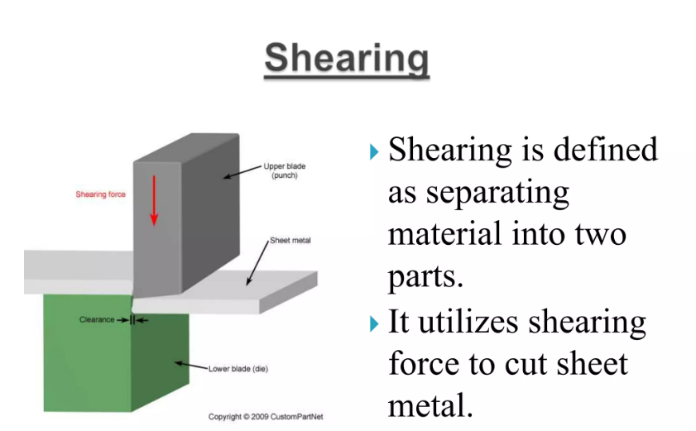

Slide 12
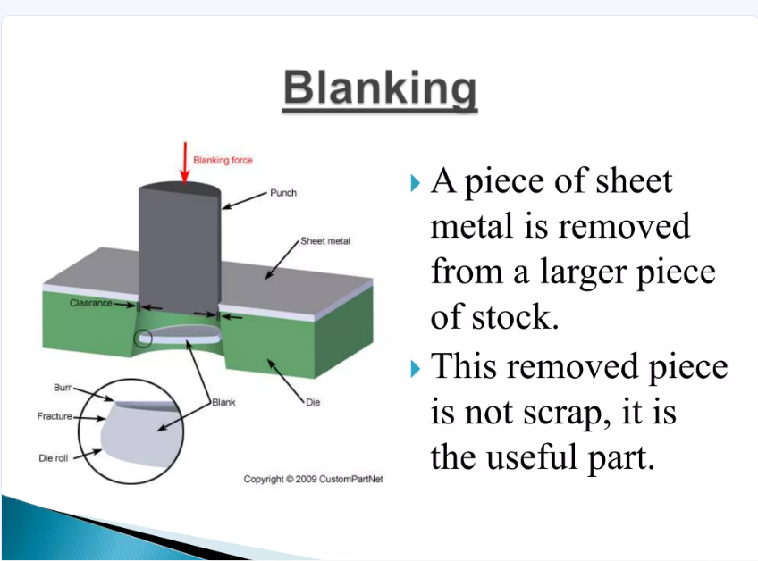

Slide 13
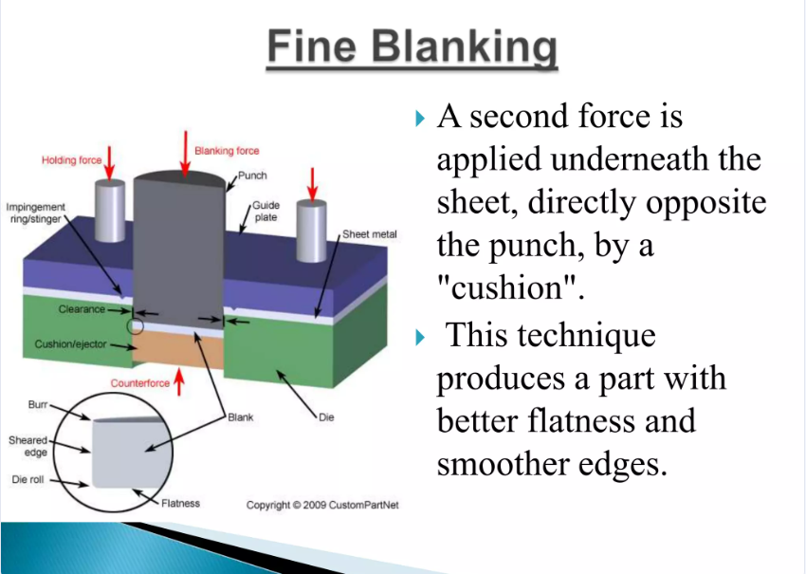

Slide 14
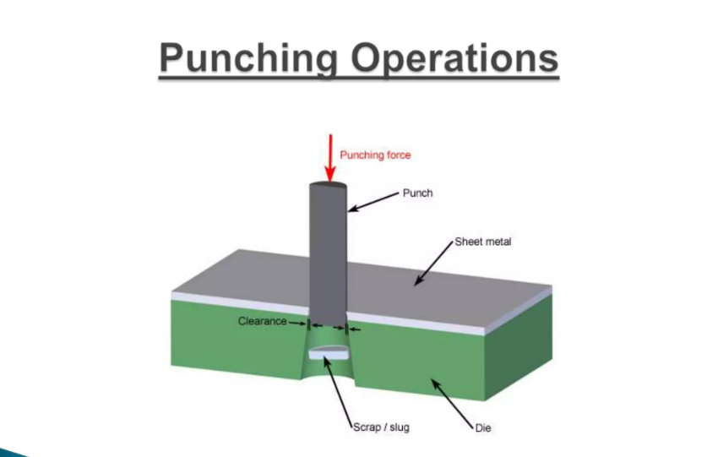

Slide 15
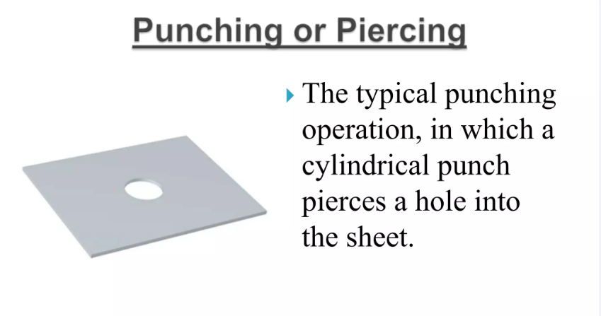

Slide 16
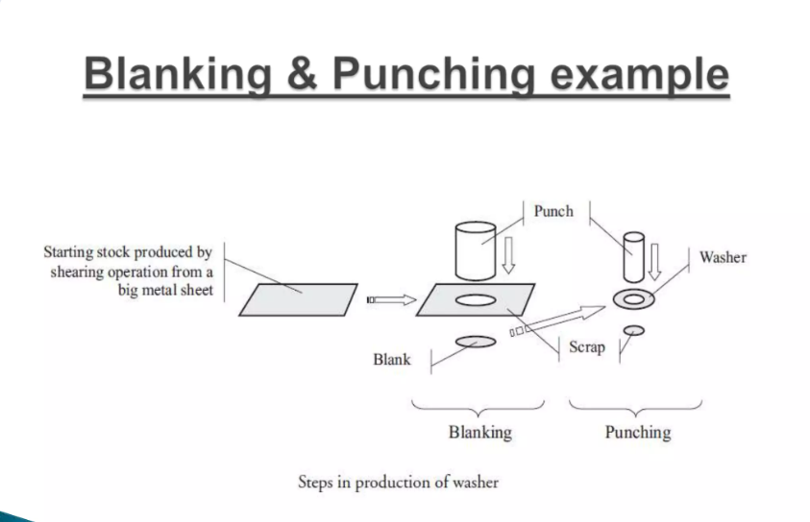

Slide 17
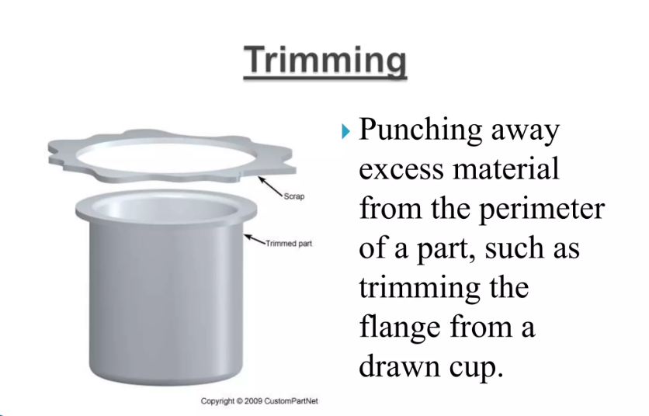

Slide 18
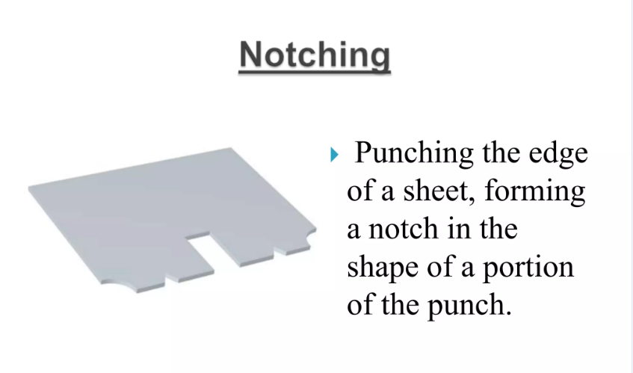

Slide 19
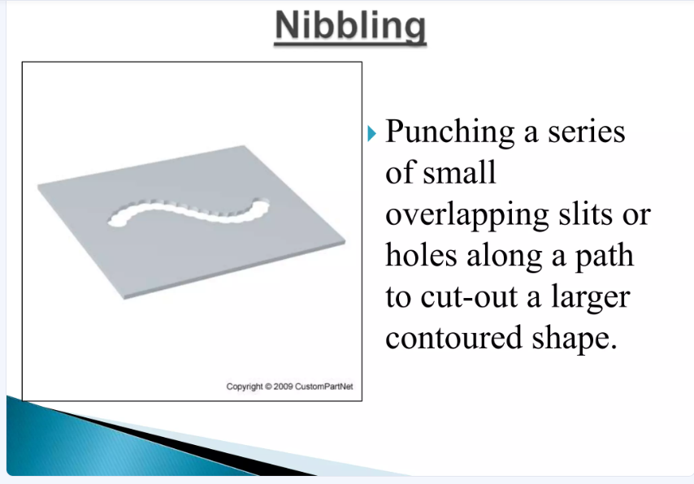

Slide 20
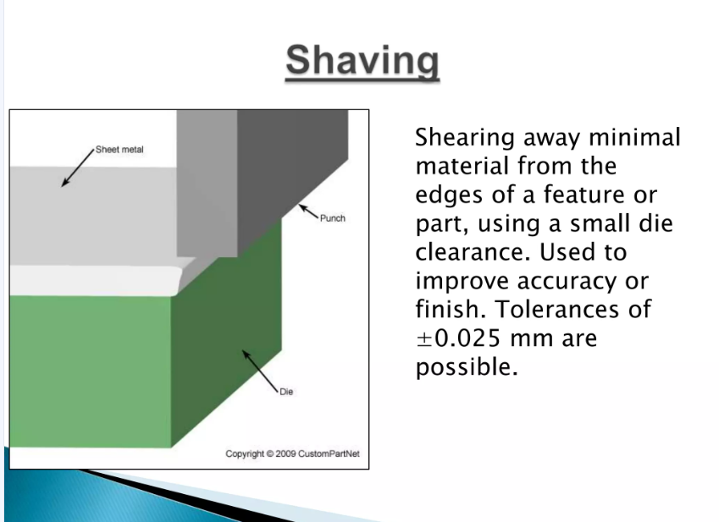

Slide 21
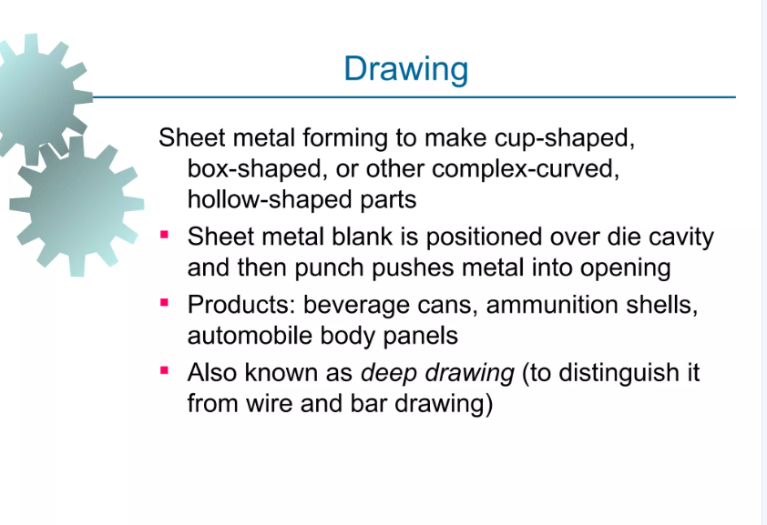

Slide 22
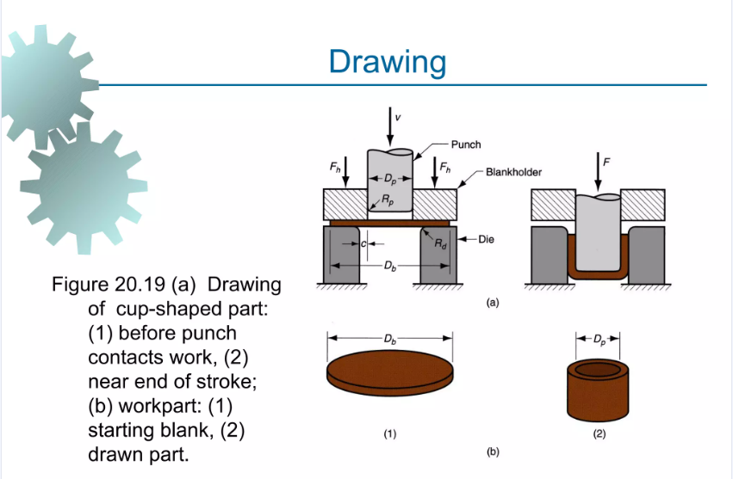

Slide 23
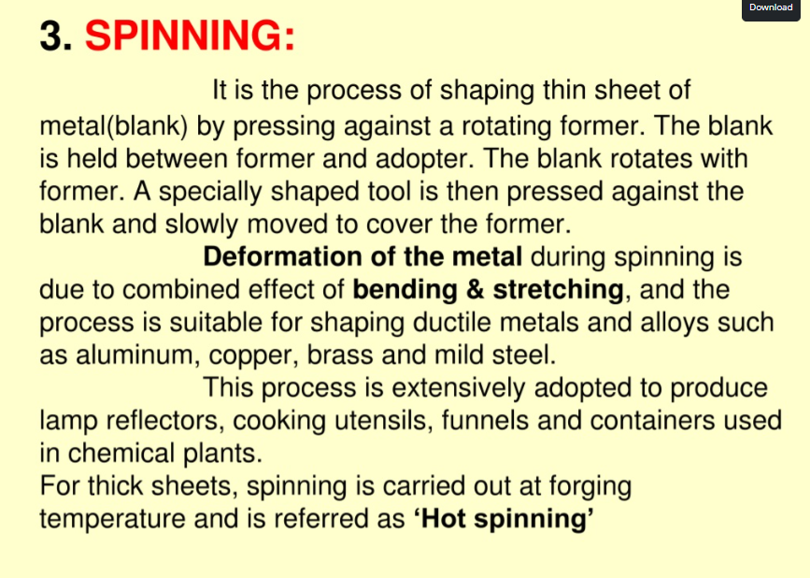

Slide 24
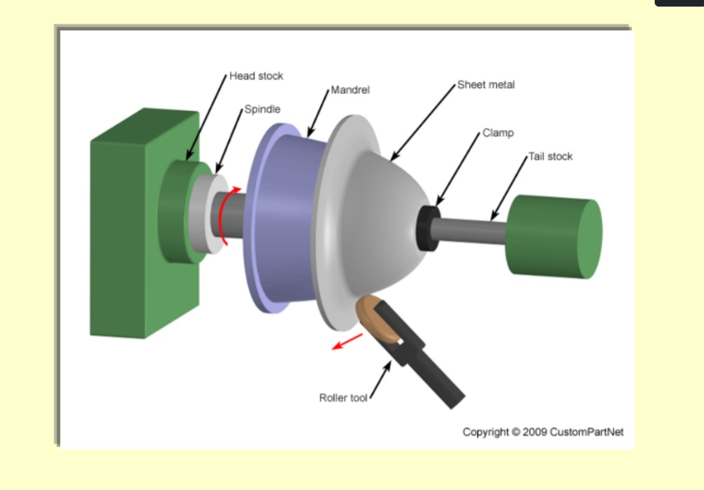

Slide 25
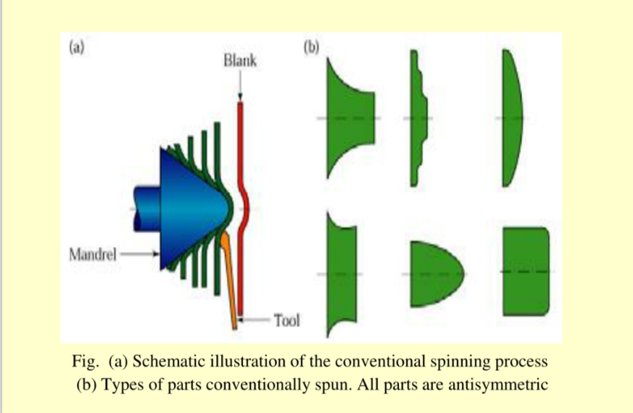

Slide 26
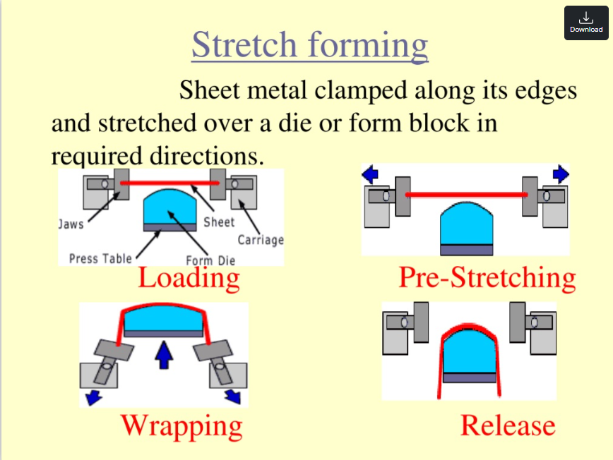

Slide 27
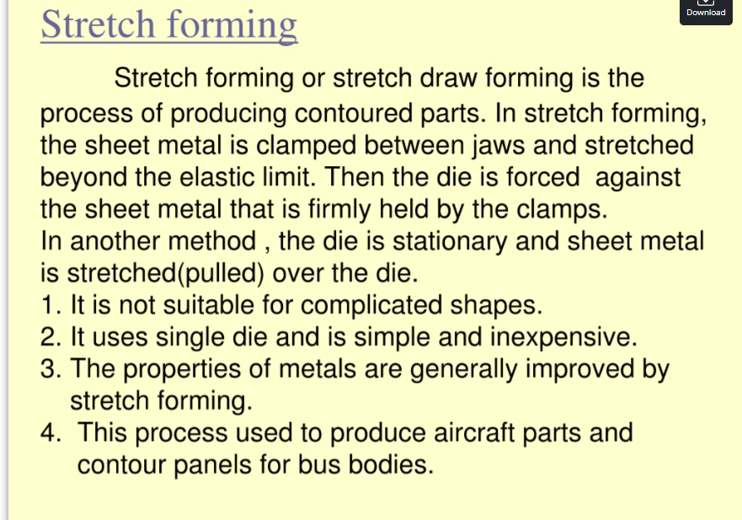

Slide 28
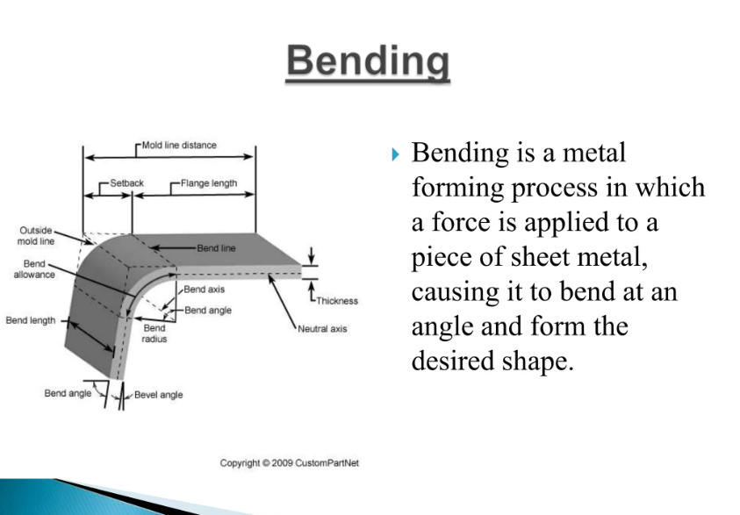

Slide 29
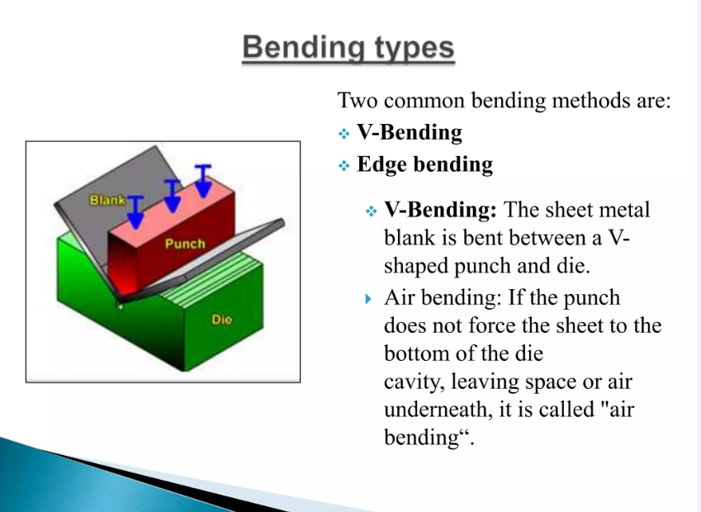

Slide 30
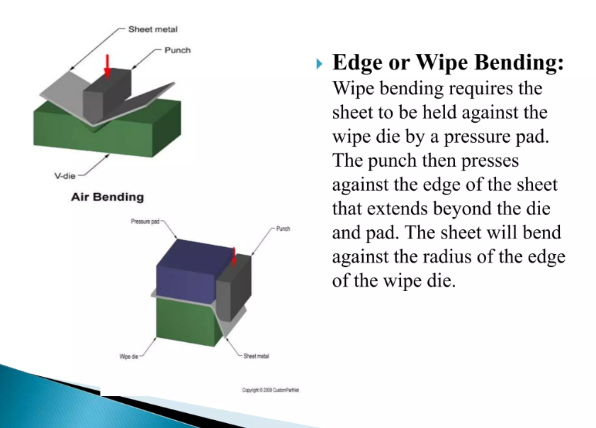

Slide 31
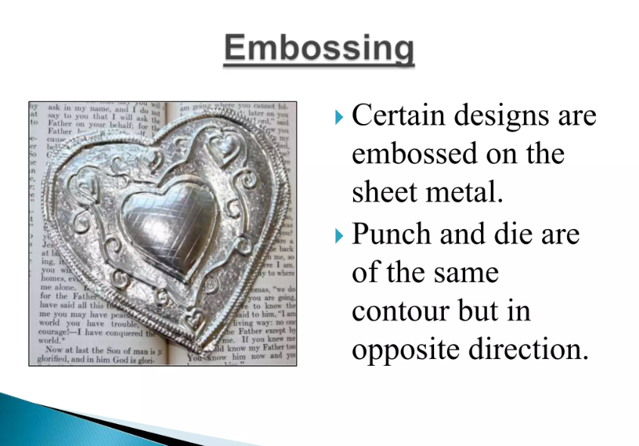

Slide 32
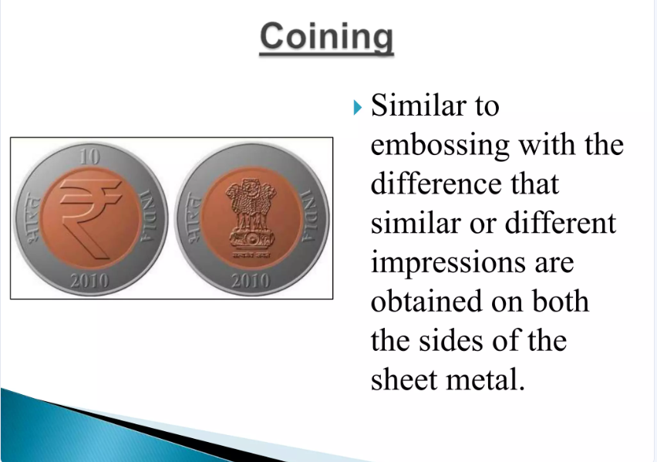

Slide 33
Forging
It is the operation where the metal is heated and then a force is applied to manipulate the metal in such a way that the required final shape is obtained.
This is the oldest of the metal-working processes known to mankind since copper age.
Forging is generally hot-working operation though cold forging is used sometimes.
Types of Forging:
There are four types of forging methods, which are generally used
Smith forging
Drop forging
Press forging
Machine forging

Slide 34
1. Smith Forging:
This is the traditional forging operation done openly or in open dies by the village blacksmith or modern shop floor by manual hammering or by power hammers.
2. Drop Forging:
This is the operation done in closed impression dies by means of the drop hammers. Here the force for shaping the component is applied in a series of blows.
3. Press Forging:
Similar to drop forging, the press forging is also done in closed-impression dies with the exception that the force is a continuous squeezing type applied by the hydraulic presses.
4. Machine Forging:
Unlike the drop or press forging where the material is drawn out, in machine forging the material is only upset to get the desired shape.

Slide 35
Forging Defects:
Though the forging process generally gives superior quality products compared to other manufacturing pocesses, still there are some defects that are likely to come if proper care is not taken in the forging-process design.
Unfilled Sections:
In this, some sections of the die cavity are not completely filled by the flowing metal. The causes of this defect are improper design of forging die or using faulty forging techniques.
2. Cold Shut:
This appears as a small crack at the corners of the forging. This is caused mainly by the improper design of the die where in the corner and fillet radii are small as a result of which the metal do not flow properly into the corner and ends up as a cold shut.

Slide 36
3. Scale Pits:
This is seen as irregular depressions on the surface of the forging. This is primarily caused because of the improper cleaning of the stock used for forging. The oxide and scale present on the stock surface gets embedded into the finished forging surface. When the forging is cleaned by pickling, these are seen as depressions on the forging surface.
4. Die Shift:
This is caused by the misalignment of the two die halves, making the two halves of the forging to be of improper shape.
5. Flakes:
These are basically internal ruptures caused by the improper cooling of the large forging. Rapid cooling causes the exteriors to cool quickly causing internal fractures. This can be remedied by following proper cooling practice.

Slide 37
6. Improper Grain Flow:
This is caused by the improper design of the die, which makes the flow of the not following the final intended directions.

